Slide 1
“Old Age” burials throughout the years

Slide 2
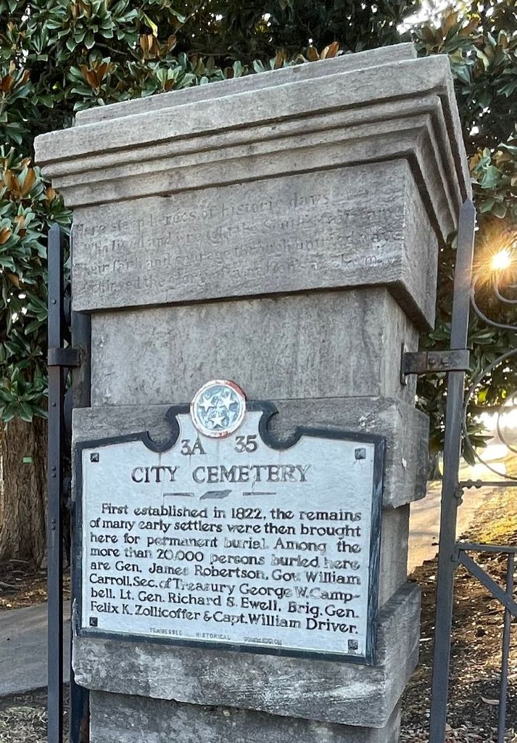
What are we looking for?
Analyze the City Cemeteries data set to take a deeper look into every death/burial that was to be considered “old age” or within the 65+ age group.
View how the data progressed through the years and see if there were any major contributing factors to changes discovered.
What do the historical records classify as a cause of burial/death being Old Age exactly?
Where there any advancements made medically to change the data as it progressed through the years?

Slide 3
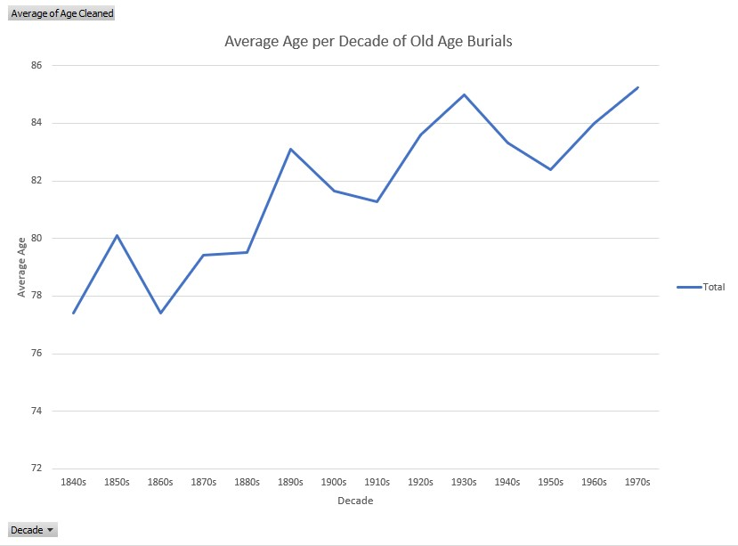
Average burial age by decade
- Youngest “Old Age” burial was 50 years old.
- Burial was for a slave of J.W Martin by the name of Barby in 1848.
- Oldest burial was 109 years old.
- Burial was for Jenny McFarland in 1870.

Slide 4
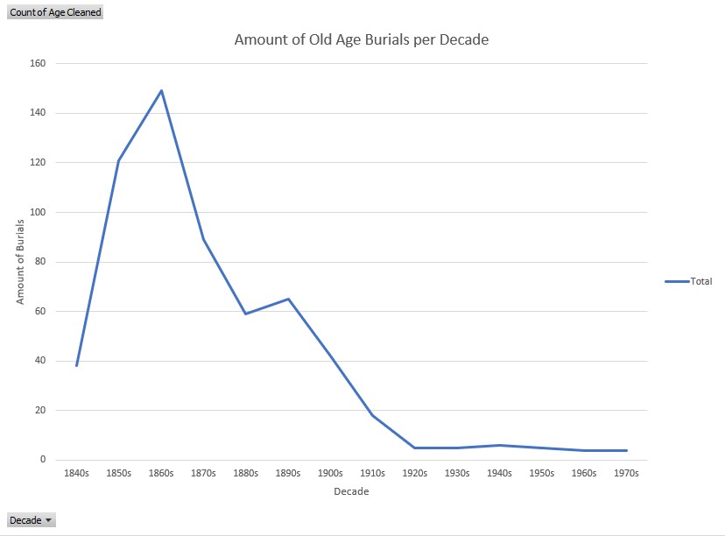
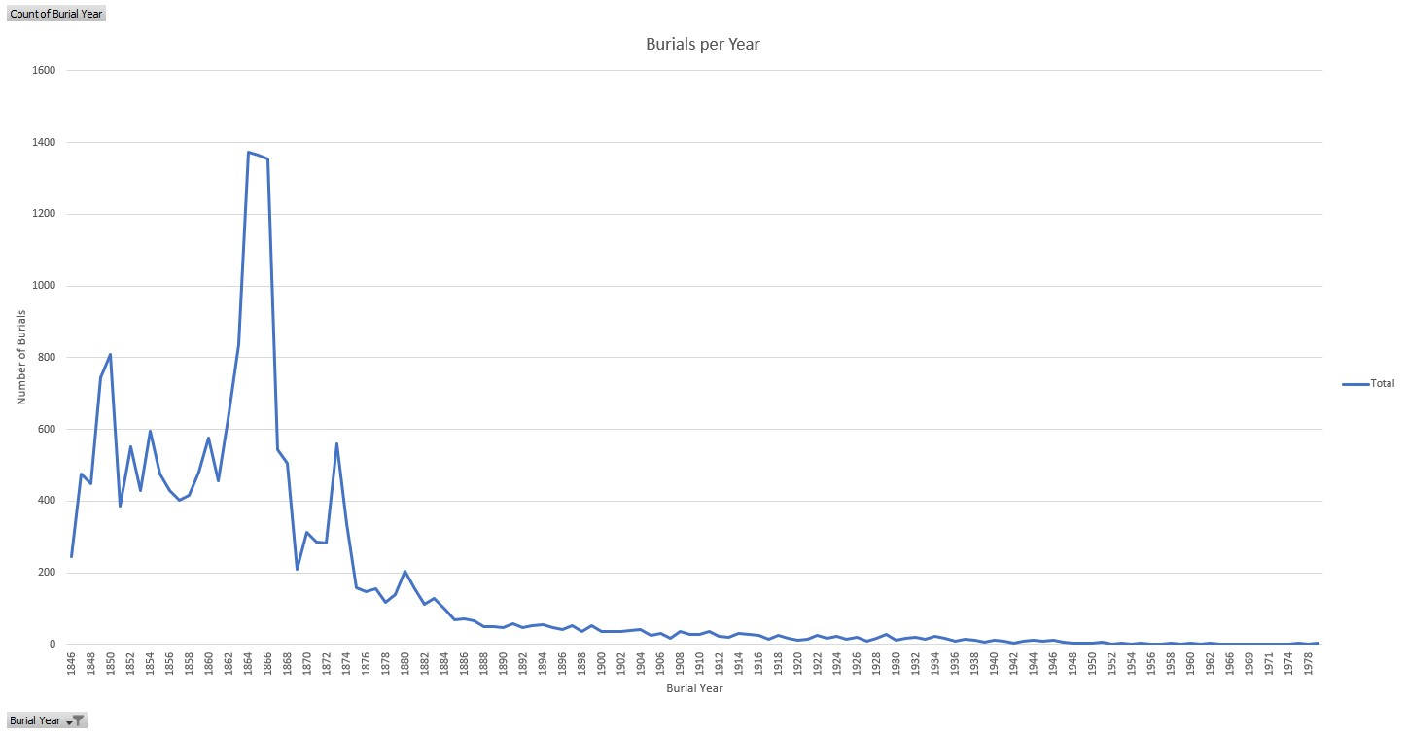
Number of burials per decade
The total amount of “Old Age” burials severely decreases as the years, despite people living longer as the years go on.
Trend follows a very similar path as the total number of burials in this cemetery throughout the years recorded.

